Slide 1
ALGEBRA 4
Day 54

Slide 2
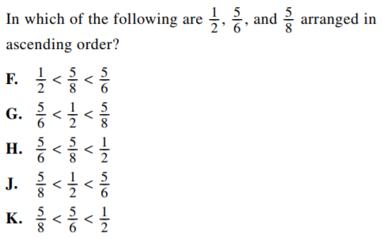
Bell Work

Slide 3
Review from 11.1
Fundamental Counting Principle:
Event 1: 8 ways Event 2: 12 ways Event 3: 10 ways
Factorial:
9! 0! 3! x 5!
Permutation: order does matters
Example: phone number
Combinations: order does NOT matter
Example: order at mcdonalds

Slide 4
Example
Find the number of permutations:
₁₀P₆ ₅P₂
Find the number of combinations:
₁₀C₆ ₉C₃

Slide 5
Permutation or Combination?
Example: You are considering 10 different colleges. Before you decide to apply to the colleges, you want to visit some of them. In how many ways can you visit,
6 of the colleges?

Slide 6
Multiple Events: Event A and Event B → Multiply Event A or Event B → Add

Slide 7
Example: A restaurant serves omelets that can be ordered with any of the ingredients shown.
Vegetarian Meat
Green Pepper Ham
Red Pepper Bacon
Onion Sausage
Mushroom Steak
Tomato
Cheese

Slide 8
Answer the following:
a) Suppose you want exactly 2 vegetarian ingredients and 1 meat ingredient in your omelet. How many different types of omelets can you order?
b) Suppose you can afford at most 3 ingredients in your omelet. How many different omelets can you order?

Slide 9
For Next Time
Page 678 #1-6, 9-11, 13-19 (odd), 20, 21-37 (odd), 38-41

Slide 10
11.2 Probability
Objective: To find the probability of an event using theoretical, experimental, and simulation methods
Probability: the likelihood an event will occur indicated by a number between 0 and 1
(Can be written as a fraction, decimal, or percentage)
1 = will always occur
0 = will never occur

Slide 11
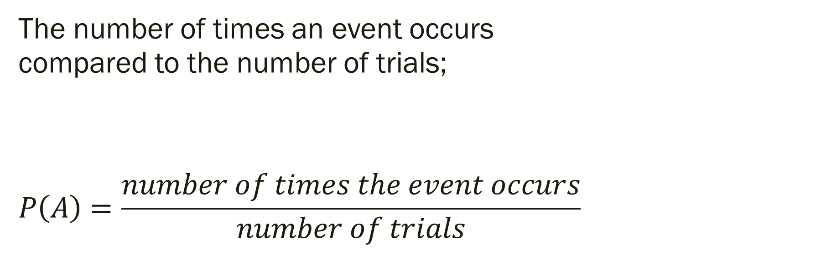
Experimental Probability:
The number of times an event occurs compared to the number of trials;
$$P\left(A\right)=\frac{number of times the event occurs}{number of trials}$$

Slide 12
Theoretical Probability:
The probability that an event will occur can be represented by;

Slide 13
Example: Experimental or Theoretical?
1.) Roll a die 30 times and record the amount of times each number shows up. What do you find? How does it compare to what you’d expect?
2.) You roll a six-sided die whose sides are numbered from 1 through 6. Find the probability of:
a.) Rolling a 4 b.) Rolling an odd number

Slide 14
Answer the following:
A jar contains 2 red marbles, 3 blue marbles, and 1 green marble. Find the probability of randomly drawing the given type of marble.
1) A red marble
2) A green marble
3) A yellow marble
4) A blue or a green marble
5) A red or a blue marble
6) A red or blue or green marble

Slide 15
Think Deeper…
You put a CD that has 8 songs in your CD player. You set the player to play the songs at random. The player plays all 8 songs without repeating any song.
1) What is the probability that the songs are played in the same order they are listed on the CD?
2) You have 4 favorite songs on the CD. What is the probability that 2 of your favorite songs are played first, in any order?

Slide 16
For Next Time
Page 685 #1-5, 7-9, 13-24, 29-33

